Slide 2
Multilingual in SPFx
Jayakumar Balasubramaniam

Slide 3





Jayakumar Balasubramaniam
Product Lead @
Working on Microsoft 365, SharePoint & Azure
Speaker | Blogger
jayakumar@live.in
jayakumarbalasubramaniam
@jayakumrB
jayakumrb

Slide 4
Why we need to localize Webparts
Localize Web Part Metadata
Localize Web Part Contents
Localize Web Part Settings Values
Testing Localization

Slide 5

Why we need to localize Webparts
Diverse environment.
Users can consume contents in their preferred language.

Slide 6
Demo

Slide 7
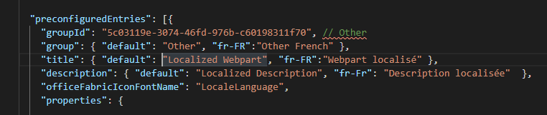
Localize Web Part Metadata
The manifest provides information about the web part like title, description. \src\webparts\localized\LocalizedWebPart.manifest.json
If the user preferred language is not supported by your SharePoint site, then the default will be used.
The first part of locale name needs to be in lowercase letters while the last part has to be written in uppercase. Example: ("fr-FR").

Slide 8
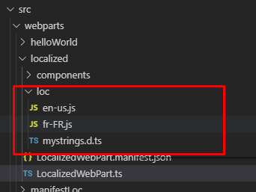
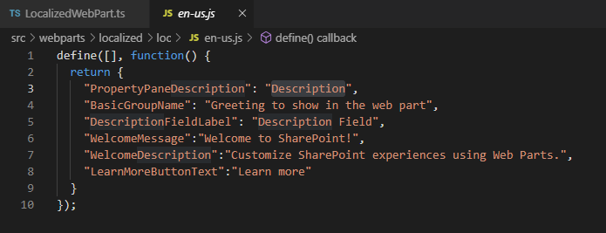
Localize Web Part Contents
The localization files used by the web part are stored in the ./src/webparts/localized/loc folder.
Localized string contents are configured in a JavaScript resource file.
mystrings.d.ts is the definition file which defines the strings included in the localized resource files.
All keys specified in the TypeScript type definition file for localization have translations in all localization JavaScript resource files.

Slide 9
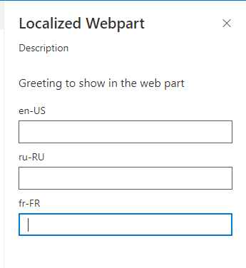
Localize Web Part Settings Values
Values configured through property pane is not saved in resource files.
Use the building blocks provided with the SharePoint Framework to get setting values for each locale

Slide 10

Testing Localization in Development
Specify the locale to be tested by using the command-line argument when you do the gulp serve.
The locale given in the gulp task will become the default language for the webpart.
Unfortunately, the SharePoint Workbench doesn't currently support previewing the localized values from the web part manifest.

Slide 11
References
Localize web parts: https://docs.microsoft.com/en-us/sharepoint/dev/spfx/web-parts/guidance/localize-web-parts
Localize Communication Sites: https://spo.ms/mlp
This Webinar Sample Project Git Hub Link:
https://github.com/JayakumarB/Multilingual-in-SPFx

